Slide 1
Programming output
By Riane Marc Nocillado

Slide 2

Exercise 1

Slide 3

Exercise 2

Slide 4
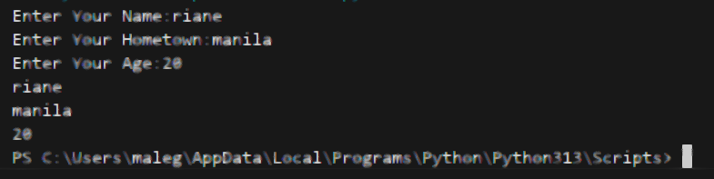
Exercise 3
Notes:
I don’t know why this is like that blur
An I don’t know how to make it clear

Slide 5
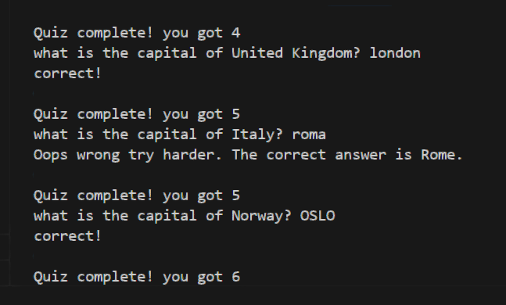
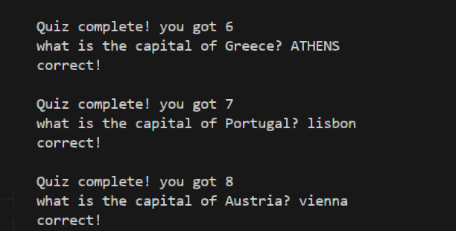
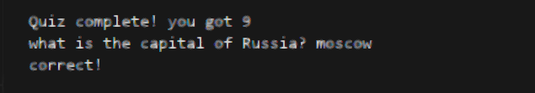
Exercise 4

Slide 6

Exercise 5

Slide 7
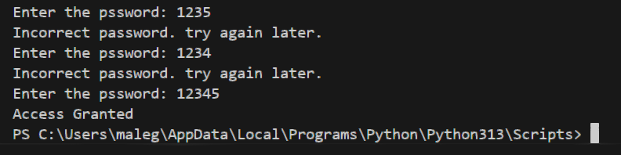
Exercise 6

Slide 8
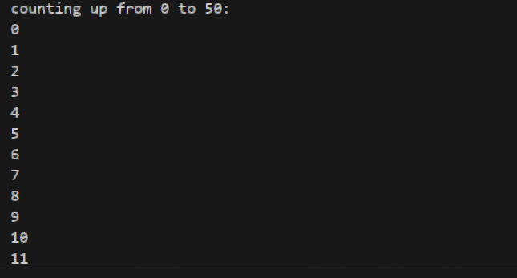
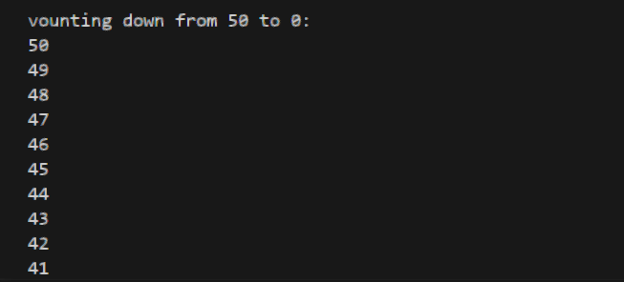
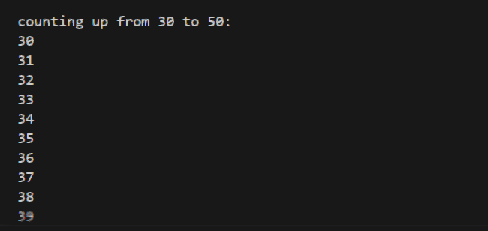
Exercise 7

Slide 9

Exercise 8

Slide 10
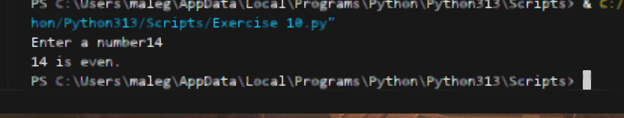
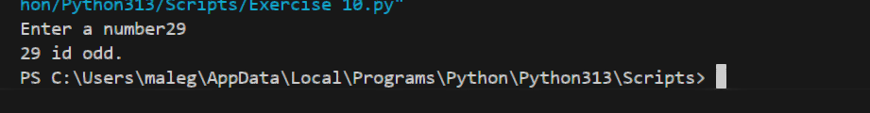
Exercise 10

